Slide 1


Regression with Discrete Dependent Variable
Ekonometrika untuk Penelitian
Muhammad Akmal Farouqi
05/6/2024
www.ugm.ac.id
Locally Rooted, Globally Respected

Slide 2
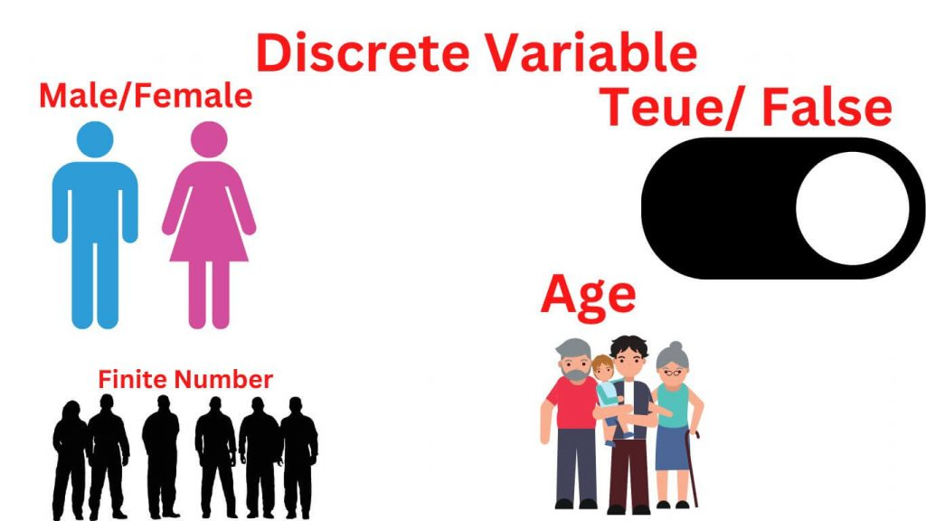
Discrete Variable
A discrete variable is a type of variable in statistics that can only take on a finite or countably infinite set of values. In other words, the variable can only take on certain specific values and not any values within a range. Such as the number of siblings a person has or the number of days per week that a person exercises
In this lecture, we only cover few types of discrete variables that can be analyzed using logistic regression
Dichotomous variables (Boolean): These variables can only take on two values
Nominal variables: These variables can take on a set of values that are not ordered
Ordinal variables: These variables can take on a set of values that are ordered

Slide 3
Why OLS is not applicable in this data?
OLS might predict outside the range [0,1]
Error variance is not constant with binary Y
Error are not normally distributed (residuals are not continuous)
This leads to inefficient and biased estimates of both coefficients and standard errors in OLS.

Slide 4
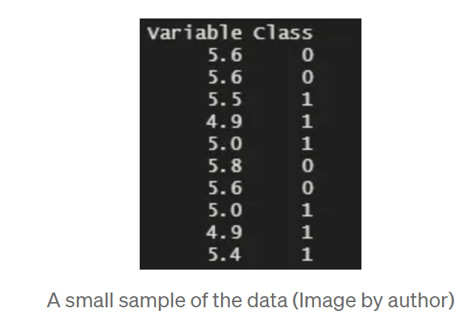
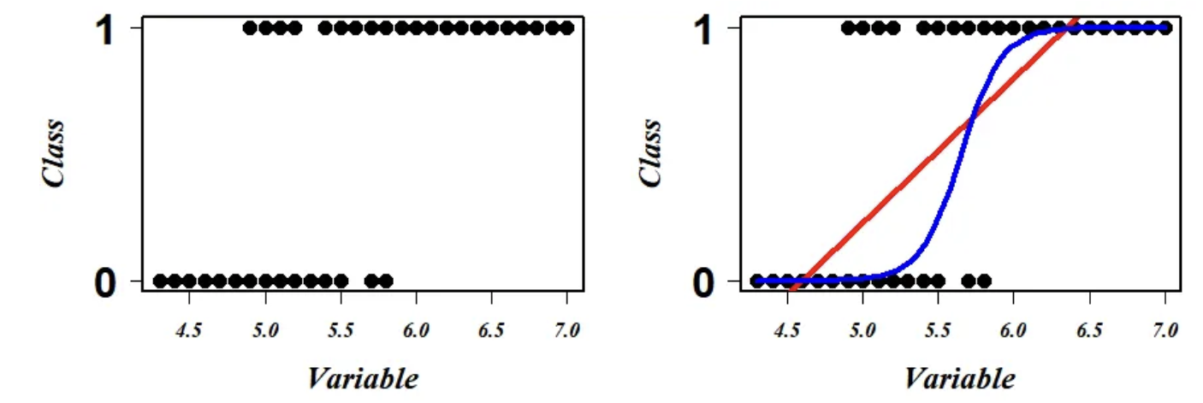

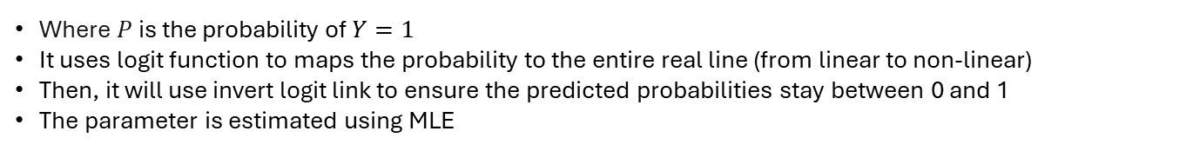
Binary Logistic Regression
Binary logistic regression is used when the dependent variable is binary (i.e., it has two possible outcomes, typically coded as 0 and 1). The main goal is to model the probability that the dependent variable equals 1 (the event of interest), given a set of independent variables.
$$logit\left(P\right)=\log\left(\frac{P}{1−P}\right)=β_{0}+β_{1}X_{1}+…+β_{k}X_{k}$$
Where $P$ is the probability of $Y=1$
It uses logit function to maps the probability to the entire real line (from linear to non-linear)
Then, it will use invert logit link to ensure the predicted probabilities stay between 0 and 1
The parameter is estimated using MLE

Slide 5

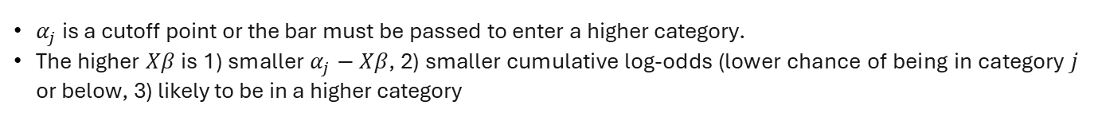

Multinomial Logit Regression
Used when the outcome has more than two categories, and no natural order (e.g., choosing a mode of transport: car, bus, bike).
The model estimates the log-odds of each outcome relative to a baseline category:
$$\log\left(\frac{P\left(Y=j\right)}{P(Y=base}\right)=β_{j0}+β_{j1}X_{1}+…+β_{jk}X_{k}$$
For $J$ categories, the estimation will be on $J−1$ sets of coefficients
Ordered Logit Regression
Ordered logit models the cumulative probabilities of being in or below a given category.
Instead of estimating the probability of each category directly, it estimates the log-odds of being in category $j$ or below:
$$\log\left(\frac{P\left(Y≤j\right)}{P(Y>j}\right)=α_{j}−(β_{1}X_{1}+…+β_{k}X_{k})$$
$α_{j}$ is a cutoff point or the bar must be passed to enter a higher category.
The higher $Xβ$ is 1) smaller $α_{j}−Xβ$, 2) smaller cumulative log-odds (lower chance of being in category $j$ or below, 3) likely to be in a higher category

Slide 6
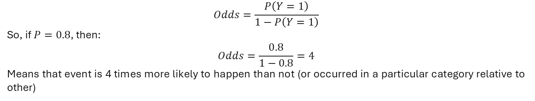
Interpreting Logit Regression
The coefficient estimated from Logit Regression usually presented in odds ratios, which represent changes in the log-odds. Interpret this is much more difficult! Thus, we should transform our coefficient into these two:
Odds
Odds are the ratio of the probability of an event happening to it not happening:
$$Odds=\frac{P\left(Y=1\right)}{1−P\left(Y=1\right)}$$
So, if $P=0.8$, then:
$$Odds=\frac{0.8}{1−0.8}=4$$
Means that event is 4 times more likely to happen than not (or occurred in a particular category relative to other)
Marginal Effects
Marginal effects measure the change in the predicted probability of the outcome from a 1-unit change in a predictor (holding others constant).
If a marginal effect of income is 0.04:A one-unit increase in income increases the probability of the outcome (e.g., being employed) by 4 percentage points.

Slide 7
Logit vs Probit
he logit and probit models are very similar and often used interchangeably for binary outcomes. But they differ in one key place: the link function.
In general:
Logit uses the logistic distribution, which has slightly heavier tails than the normal distribution.
Probit uses the standard normal distribution, so it assumes a latent normality.
Feature | Logit | Probit
Link Function | Logistic (log-odds) | Standard Normal (Z-scores)
Coefficient Meaning | Log-odds | Z-value (in standard normal)
Interpretation | Odds Ratios | Changes in normal probability
Tail Behavior | Heavier tails (more robust) | Lighter tails
Output | Predicted probabilities | Predicted probabilities
Oftentimes, the choice of deciding the link relies on the model’s goodness-of-fit

Slide 8
Thank You

